Slide 1
ENGG104 Electrical Systems
TEXTBOOK
Introductory Circuit Analysis, Boylestad, 12th Ed
Lecture 7
Attribution Nidhal Abdulaziz

Slide 2
Lecture 7 summary
(Boylestad – Chapter 11, 12)
Self Inductance
Induced Voltage
Inductors in Series and Parallel
Transients in R-L circuits
Time Constants
Energy Storage
Notes:
Become familiar with the basic construction of an inductor, the factors that affect the strength of the magnetic field established by the element, and how to read the nameplate data. Be able to determine the transient (time-varying) response of an inductive network and plot the resulting voltages and currents. Understand the impact of combining inductors in series or parallel. Develop some familiarity with the use of PSpice or Multisim to analyze networks with inductive elements.

Slide 3
The Inductor
Three basic components appear in the majority of electrical/electronic systems in use today.
They include the resistor and the capacitor, which have already been introduced, and the inductor.
In many ways, the inductor is the dual of the capacitor; that is, the voltage of one is applicable to the current of the other, and vice versa.
Like the capacitor, the inductor exhibits its true characteristics only when a change in voltage or current is made in the network.
Notes:
Three basic components appear in the majority of electrical/electronic systems in use today. They include the resistor and the capacitor, which have already been introduced, and the inductor , to be examined in detail in this chapter. In many ways, the inductor is the dual of the capacitor; that is, the voltage of one is applicable to the current of the other, and vice versa. In fact, some sections in this chapter parallel those in Chapter 10 on the capacitor. Like the capacitor, the inductor exhibits its true characteristics only when a change in voltage or current is made in the network. Recall from Chapter 10 that a capacitor can be replaced by an open-circuit equivalent under steady-state conditions. You will see in this chapter that an inductor can be replaced by a short-circuit equivalent under steady-state conditions. Finally, you will learn that while resistors dissipate the power delivered to them in the form of heat, ideal capacitors store the energy delivered to them in the form of an electric field. Inductors, in the ideal sense, are like capacitors in that they also store the energy delivered to them—but in the form of a magnetic field.

Slide 4
The Magnetic Field
Magnetism plays an integral part in almost every electrical device used today in industry, research, or the home.
Generators, motors, transformers, circuit breakers, televisions, computers, tape recorders, and telephones all employ magnetic effects to perform a variety of important tasks.

Slide 5
The Magnetic Field
Flux distribution for a permanent magnet.
Flux distribution for two adjacent, opposite poles.
Notes:
A magnetic field exists in the region surrounding a permanent magnet, which can be represented by magnetic flux lines similar to electric flux lines. Magnetic flux lines, however, do not have origins or terminating points as do electric flux lines but exist in continuous loops, as shown in Fig. 11.1.
The magnetic flux lines radiate from the north pole to the south pole, returning to the north pole through the metallic bar. Note the equal spacing between the flux lines within the core and the symmetric distribution outside the magnetic material. These are additional properties of magnetic flux lines in homogeneous materials (that is, materials having uniform structure or composition throughout). It is also important to realize that the continuous magnetic flux line will strive to occupy as small an area as possible. This results in magnetic flux lines of minimum length between the unlike poles, as shown in Fig. 11.2. The strength of a magnetic field in a particular region is directly related to the density of flux lines in that region. In Fig. 11.1, for example, the magnetic field strength at point a is twice that at point b since twice as many magnetic flux lines are associated with the perpendicular plane at point a than at point b. Recall from childhood experiments that the strength of permanent magnets is always stronger near the poles.

Slide 6
Effect of Metal on Magnetic Field
Flux distribution for two adjacent, like poles.
Effect of a ferromagnetic sample on the flux distribution of a permanent magnet.
Notes:
If a nonmagnetic material, such as glass or copper, is placed in the flux paths surrounding a permanent magnet, an almost unnoticeable change occurs in the flux distribution (Fig. 11.4). However, if a magnetic material, such as soft iron, is placed in the flux path, the flux lines pass through the soft iron rather than the surrounding air because flux lines pass with greater ease through magnetic materials than through air. This principle is used in shielding sensitive electrical elements and instruments that can be affected by stray magnetic fields (Fig. 11.5).

Slide 7
The Magnetic Field and a Current Carrying wire
A magnetic field is present around every wire that carries an electric current.
The direction of the magnetic flux lines can be found simply by placing the thumb of the right hand in the direction of conventional current flow and noting the direction of the fingers.
Remember it’s the movement of electrons that creates the magnetic Field
Notes:
A magnetic field (represented by concentric magnetic flux lines, as in Fig. 11.6) is present around every wire that carries an electric current. The direction of the magnetic flux lines can be found simply by placing the thumb of the right hand in the direction of conventional current flow and noting the direction of the fingers. (This method is commonly called the right-hand rule.) If the conductor is wound in a single-turn coil (Fig. 11.7), the resulting flux flows in a common direction through the center of the coil. A coil of more than one turn produces a magnetic field that exists in a continuous path through and around the coil (Fig. 11.8). The flux distribution of the coil is quite similar to that of the permanent magnet. The flux lines leaving the coil from the left and entering to the right simulate a north and a south pole, respectively. The principal difference between the two flux distributions is that the flux lines are more concentrated for the permanent magnet than for the coil. Also, since the strength of a magnetic field is determined by the density of the flux lines, the coil has a weaker field strength. The field strength of the coil can be effectively increased by placing certain materials, such as iron, steel, or cobalt, within the coil to increase the flux density within the coil. By increasing the field strength with the addition of the core, we have devised an electromagnet (Fig. 11.9) that not only has all the properties of a permanent magnet but also has a field strength that can be varied by changing one of the component values (current, turns, and so on). Of course, current must pass through the coil of the electromagnet for magnetic flux to be developed, whereas there is no need for the coil or current in the permanent magnet. The direction of flux lines can be determined for the electromagnet (or in any core with a wrapping of turns) by placing the fingers of your right hand in the direction of current flow around the core. Your thumb then points in the direction of the north pole of the induced magnetic flux, as demonstrated in Fig. 11.10(a). A cross section of the same electromagnet is in Fig. 11.10(b) to introduce the convention for directions perpendicular to the page. The cross and the dot refer to the tail and the head of the arrow, respectively.

Slide 8
Magnetic flux lines around a current-carrying conductor.
Flux distribution of a single-turn coil.

Slide 9
The Coil -
The fields from each coil add
FIG. 11.8 Flux distribution of a current-carrying coil.
FIG. 11.9 Electromagnet.

Slide 10
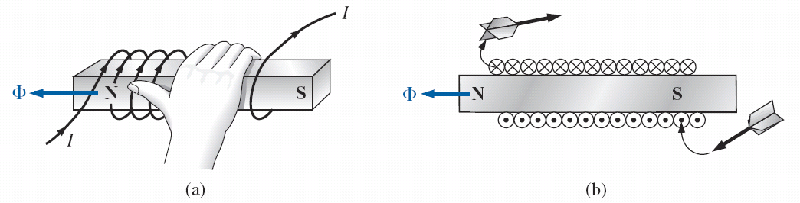
Magnetic Flux
Determining the direction of flux for an electromagnet: (a) method; (b) notation.

Slide 11
Flux, Webers and Teslas
Magnetic flux is measured in Webers (Wb) as derived from the surname of Wilhelm Eduard Weber.
The applied symbol is the capital Greek letter phi, Φ.
The number of flux lines per unit area, called the flux density, is denoted by the capital letter B and is measured in Teslas (T) to honor the efforts of Nikola Tesla, a scientist of the late 1800s
Defining the flux density B.

Slide 12
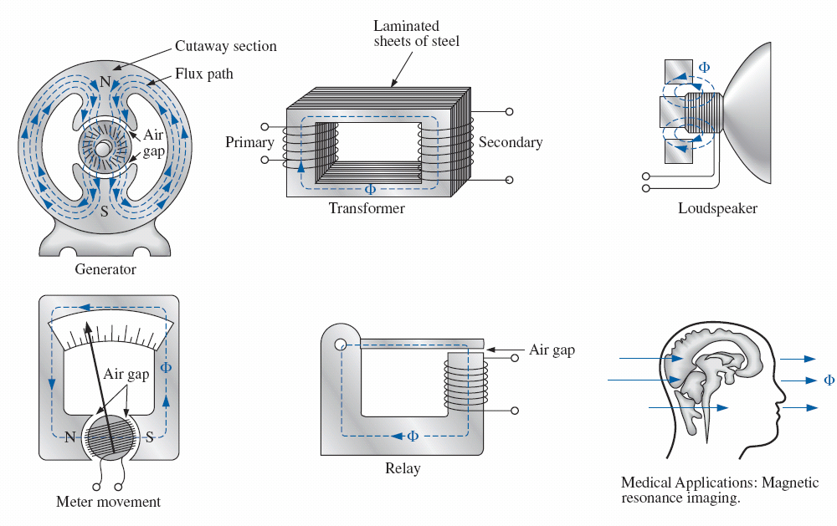
Magnetic Circuit Applications
Some areas of application of magnetic effects.

Slide 13
Inductance
We learned that sending a current through a coil of wire, with or without a core, establishes a magnetic field through and surrounding the unit.
This component, of rather simple is called an inductor (often referred to as a coil).
Its inductance level determines the strength of the magnetic field around the coil due to an applied current.
The higher the inductance level, the greater is the strength of the magnetic field.
Notes:
In the previous section, we learned that sending a current through a coil of wire, with or without a core, establishes a magnetic field through and surrounding the unit. This component, of rather simple construction (see Fig. 11.16), is called an inductor (often referred to as a coil). Its inductance level determines the strength of the magnetic field around the coil due to an applied current. The higher the inductance level, the greater is the strength of the magnetic field. In total, therefore, inductors are designed to set up a strong magnetic field linking the unit, whereas capacitors are designed to set up a strong electric field between the plates.

Slide 14
Inductance
inductors are designed to set up a strong magnetic field linking the unit, whereas capacitors are designed to set up a strong electric field between the plates.
Notice the important parameters, the larger the inductor, the stronger the magnetic Field
Defining the parameters for Eq. (11.6).

Slide 15
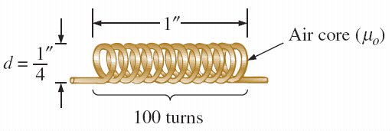
Inductance
Air-core coil
Notes:
In Chapter 10, we found that capacitance is sensitive to the area of the plates, the distance between the plates, and the dielectic employed. The level of inductance has similar construction sensitivities in that it is dependent on the area within the coil, the length of the unit, and the permeability of the core material. It is also sensitive to the number of turns of wire in the coil as dictated by the following equation and defined in Fig. 11.16 for two of the most popular shapes:
First note that since the turns are squared in the equation, the number of turns is a big factor. However, also keep in mind that the more turns, the bigger is the unit. If the wire is made too thin to get more windings on the core, the rated current of the inductor is limited. Since higher levels of permeability result in higher levels of magnetic flux, permeability should, and does, appear in the numerator of the equation. Increasing the area of the core or decreasing the length also increases the inductance level.

Slide 16
Inductor Example

Slide 17
Inductor Types
Notes:
Inductors, like capacitors and resistors, can be categorized under the general headings fixed or variable. The symbol for a fixed air-core inductor is provided in Fig. 11.20(a), for an inductor with a ferromagnetic core in Fig. 11.20(b), for a tapped coil in Fig. 11.20(c), and for a variable inductor in Fig. 11.20(d).

Slide 18
Relative sizes of different types of inductors: (a) toroid, high-current; (b) phenolic (resin or plastic core); (c) ferrite core.

Slide 19
Variable Inductors
FVariable inductors with a typical range of values from 1 mH to 100 mH; commonly used in oscillators and various RF circuits such as CB transceivers, televisions, and radios.

Slide 20
Faraday’s Law
Faraday’s law of electromagnetic induction, is one of the most important in this field because it enables us to establish ac and dc voltages with a generator.
Generating an induced voltage by moving a conductor through a magnetic field.
Notes:
Before analyzing the response of inductive elements to an applied dc voltage, we must introduce a number of laws and equations that affect the transient response. The first, referred to as Faraday’s law of electromagnetic induction , is one of the most important in this field because it enables us to establish ac and dc voltages with a generator. If we move a conductor (any material with conductor characteristics as defined in Chapter 2) through a magnetic field so that it cuts magnetic lines of flux as shown in Fig. 11.28, a voltage is induced across the conductor that can be measured with a sensitive voltmeter. That’s all it takes, and, in fact, the faster you move the conductor through the magnetic flux, the greater is the induced voltage. The same effect can be produced if you hold the conductor still and move the magnetic field across the conductor. Note that the direction in which you move the conductor through the field determines the polarity of the induced voltage. Also, if you move the conductor through the field at right angles to the magnetic flux, you generate the maximum induced voltage. Moving the conductor parallel with the magnetic flux lines results in an induced voltage of zero volts since magnetic lines of flux are not crossed.

Slide 21
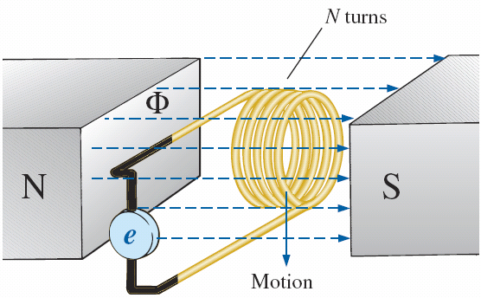
The induced Voltage
Demonstrating Faraday’s law.
Notes:
Generating an induced voltage by moving a conductor through a magnetic field. If we now go a step further and move a coil of N turns through the magnetic field as shown in Fig. 11.29, a voltage will be induced across the coil as determined by Faraday’s law:
The greater the number of turns or the faster the coil is moved through the magnetic flux pattern, the greater is the induced voltage. The term d ϕ / d t dϕ/dt is the differential change in magnetic flux through the coil at a particular instant in time. If the magnetic flux passing through a coil remains constant—no matter how strong the magnetic field—the term will be zero, and the induced voltage zero volts. It doesn’t matter whether the changing flux is due to moving the magnetic field or moving the coil in the vicinity of a magnetic field: The only requirement is that the flux linking (passing through) the coil changes with time. Before the coil passes through the magnetic poles, the induced voltage is zero because there are no magnetic flux lines passing through the coil. As the coil enters the flux pattern, the number of flux lines cut per instant of time increases until it peaks at the center of the poles. The induced voltage then decreases with time as it leaves the magnetic field.

Slide 22
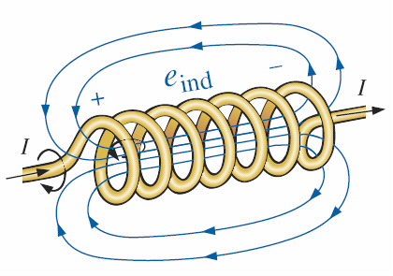
Induced Voltage
Faraday’s Law: When the magnetic flux φ cutting coil (or a wire) changes with time (or when the coil or wire moves through magnetic flux) a voltage e is induced in it
Lenz’s Law: The induced voltage in a coil opposes the voltage source that led to the establishment of flux
Demonstrating the effect of Lenz’s law.
Notes:
The equation reveals that the greater the number of turns or the greater the change in flux linking the coil due to a particular change in current, the greater is the level of inductance. In other words, coils with smaller levels of inductance generate smaller changes in flux linking the coil for the same change in current through the coil. If the inductance level is very small, there will be almost no change in flux linking the coil, and the induced voltage across the coil will be very small. In fact, if we now write Eq. (11.9) in the form

Slide 23
Inductor in a circuit
Using the circuit symbol of an inductor we can draw a circuit which represents a simple switching operation of a coil (R could be the wire resistance or an external resistance)
When the switch is closed, a current will continue to flow
As a result of L of the coil (ie, behaviour of the coil) , an induced voltage e will be developed (Note the polarity as supported by Lenz’s law).
R
E
L
e

Slide 24
R-L TRANSIENTS: THE STORAGE PHASE
A great number of similarities exist between the analyses of inductive and capacitive networks.
That is, what is true for the voltage of a capacitor is also true for the current of an inductor, and what is true for the current of a capacitor can be matched in many ways by the voltage of an inductor.
The storage waveforms have the same shape, and time constants are defined for each configuration.

Slide 25
R-L Transient
Basic R-L transient network.

Slide 26
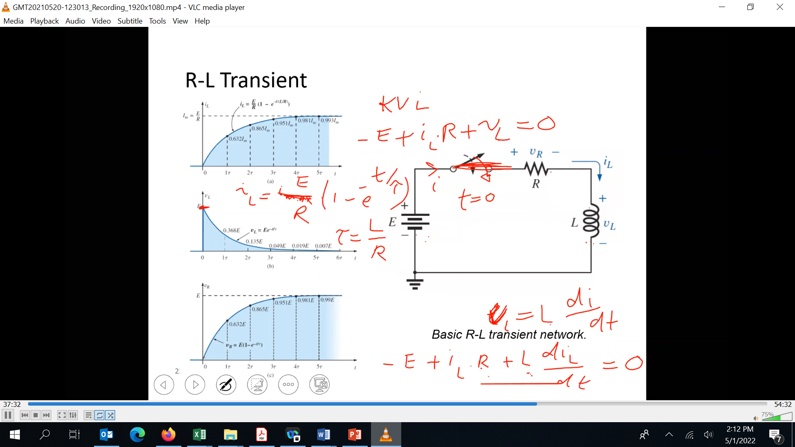





Slide 27
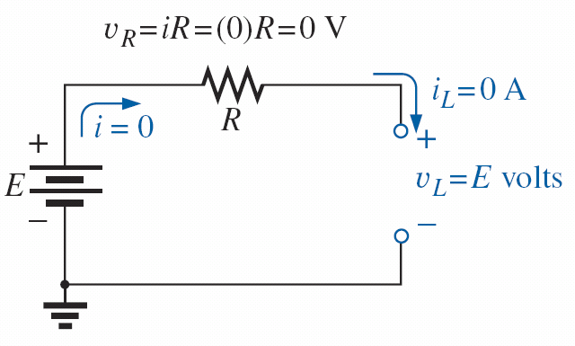
At t=0 (initial conditions)
No current flows at t=0, maximum rate of change of current, highest voltage generated, looks like an open circuit
The instant the switch is closed. T=0

Slide 28
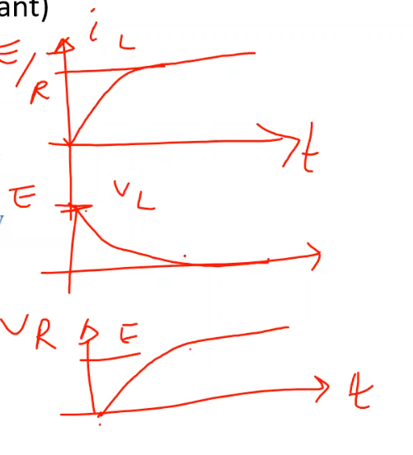
At t=∞ (steady state)
The inductor becomes a short circuit, as the current is not changing any more (DC – constant)
under steady-state conditions.

Slide 29
Example
Series R-L circuit for Example
Find i_{L}, v_{L} for this circuit

Slide 30
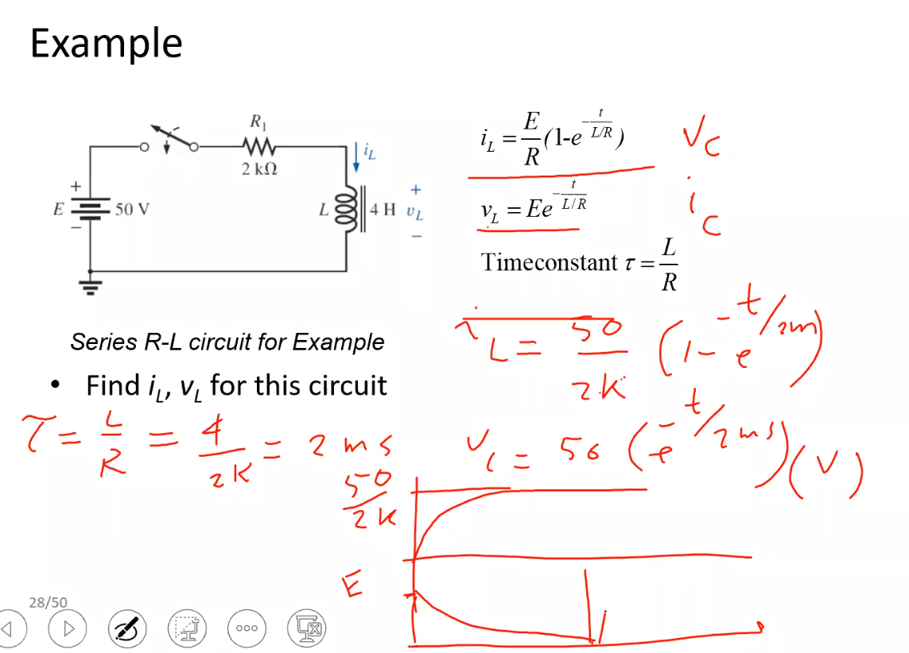

Slide 31
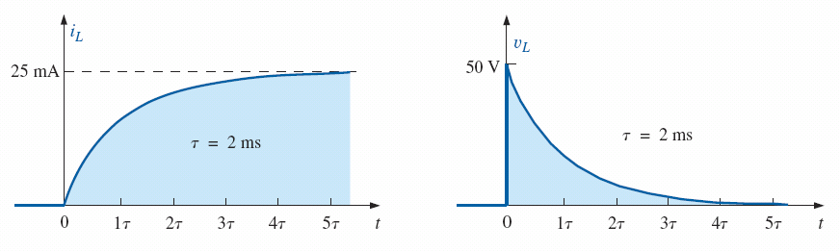
Example continued
Notice initial conditions and Final conditions
Steady state t =∞ : Current is maximum
Initial conditions t=0: max voltage
Initial conditions t=0: current is zero (open circuit)
Steady state t =∞: voltage is zero (short circuit)

Slide 32
R-L TRANSIENTS: THE RELEASE PHASE
https://www.youtube.com/watch?v=YKKd5p4a5Lo
What will the value of voltage across the switch be if the switch is opened?
Remember:
Demonstrating the effect of opening a switch in series with an inductor with a steady-state current.
Notes:
In the analysis of R-C circuits, we found that the capacitor could hold its charge and store energy in the form of an electric field for a period of time determined by the leakage factors. In R-L circuits, the energy is stored in the form of a magnetic field established by the current through the coil. Unlike the capacitor, however, an isolated inductor cannot continue to store energy because the absence of a closed path causes the current to drop to zero, releasing the energy stored in the form of a magnetic field. If the series R-L circuit in Fig. 11.41 reaches steady-state conditions and the switch is quickly opened, a spark will occur across the contacts due to the rapid change in current from a maximum of E/R to zero amperes. The change in current di>dt of the equation υ L ( d i / d t ) υL(di/dt) establishes a high voltage υ L υL across the coil that, in conjunction with the applied voltage E, appears across the points of the switch. This is the same mechanism used in the ignition system of a car to ignite the fuel in the cylinder. Some 25,000 V are generated by the rapid decrease in ignition coil current that occurs when the switch in the system is opened. (In older systems, the “points” in the distributor served as the switch.) This inductive reaction is significant when you consider that the only independent source in a car is a 12 V battery.
If opening the switch to move it to another position causes such a rapid discharge in stored energy, how can the decay phase of an R-L circuit be analyzed in much the same manner as for the R-C circuit? The solution is to use a network like that in Fig. 11.42(a). When the switch is closed, the voltage across resistor R2 is E volts, and the R-L branch responds in the same manner as described above, with the same waveforms and levels. A Thévenin network of E in parallel with R2 results in the source as shown in Fig. 11.42(b) since R2 will be shorted out by the short-circuit replacement of the voltage source E when the Thévenin resistance is determined.

Slide 33
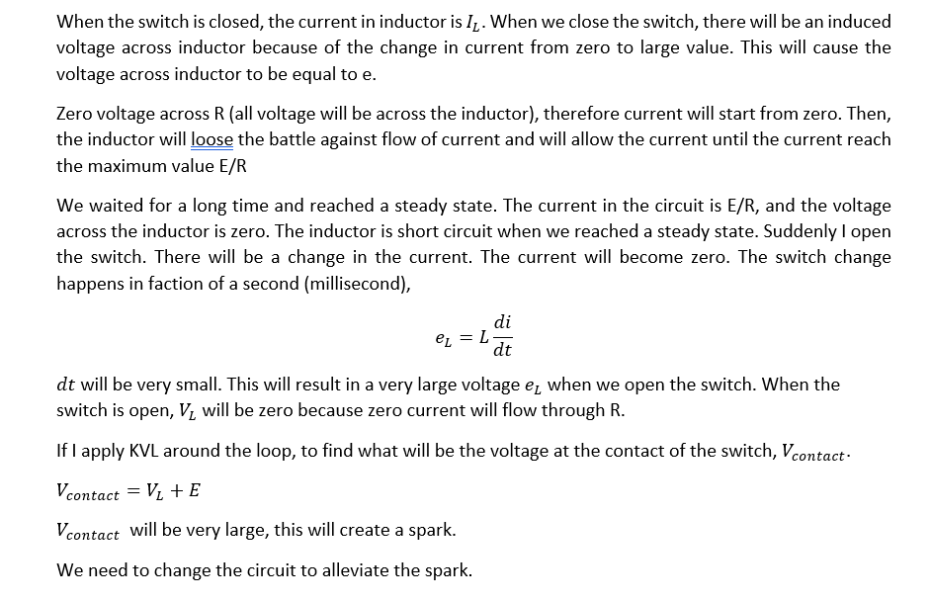

Slide 34
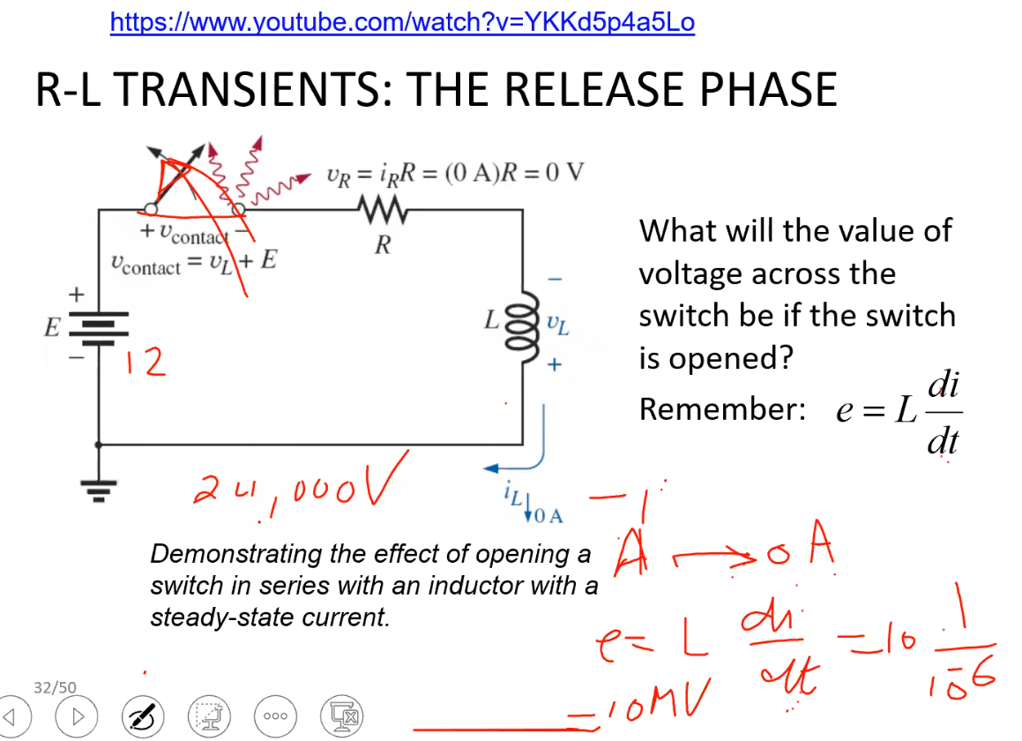

Slide 35
https://www.youtube.com/watch?v=ukBFPrXiKWA

Slide 36
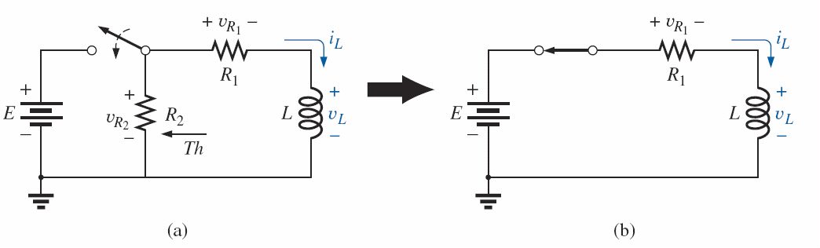
R-L TRANSIENTS: THE RELEASE PHASE
We need a path for the current to flow
Study a new charge/release circuit
Remember the inductor (or capacitor) will see the Thevenin equivalent circuit
initiating the storage phase for an inductor by closing the switch.
Notes:
After the storage phase has passed and steady-state conditions are established, the switch can be opened without the sparking effect or rapid discharge due to resistor R2 which provides a complete path for the current i L iL In fact, for clarity the discharge path is isolated in Fig. 11.43. The voltage υ L υL across the inductor reverses polarity and has a magnitude determined by

Slide 37
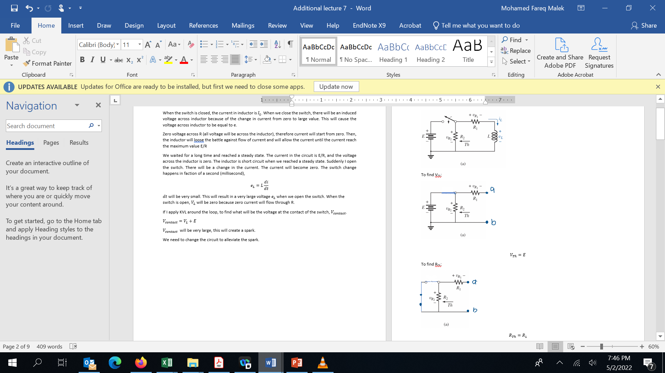
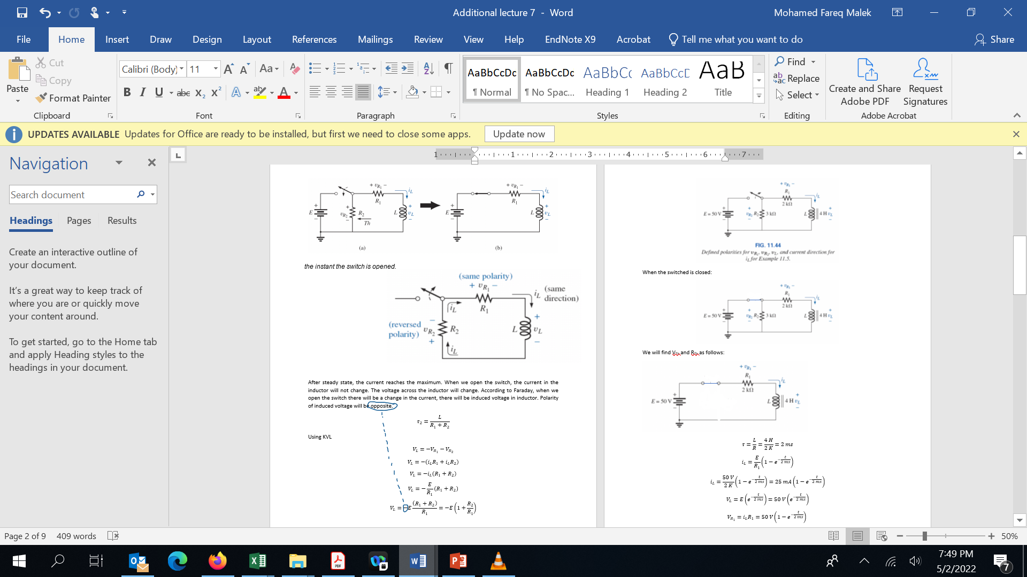







Slide 38
the instant the switch is opened.

Slide 40
Worked example

Slide 41
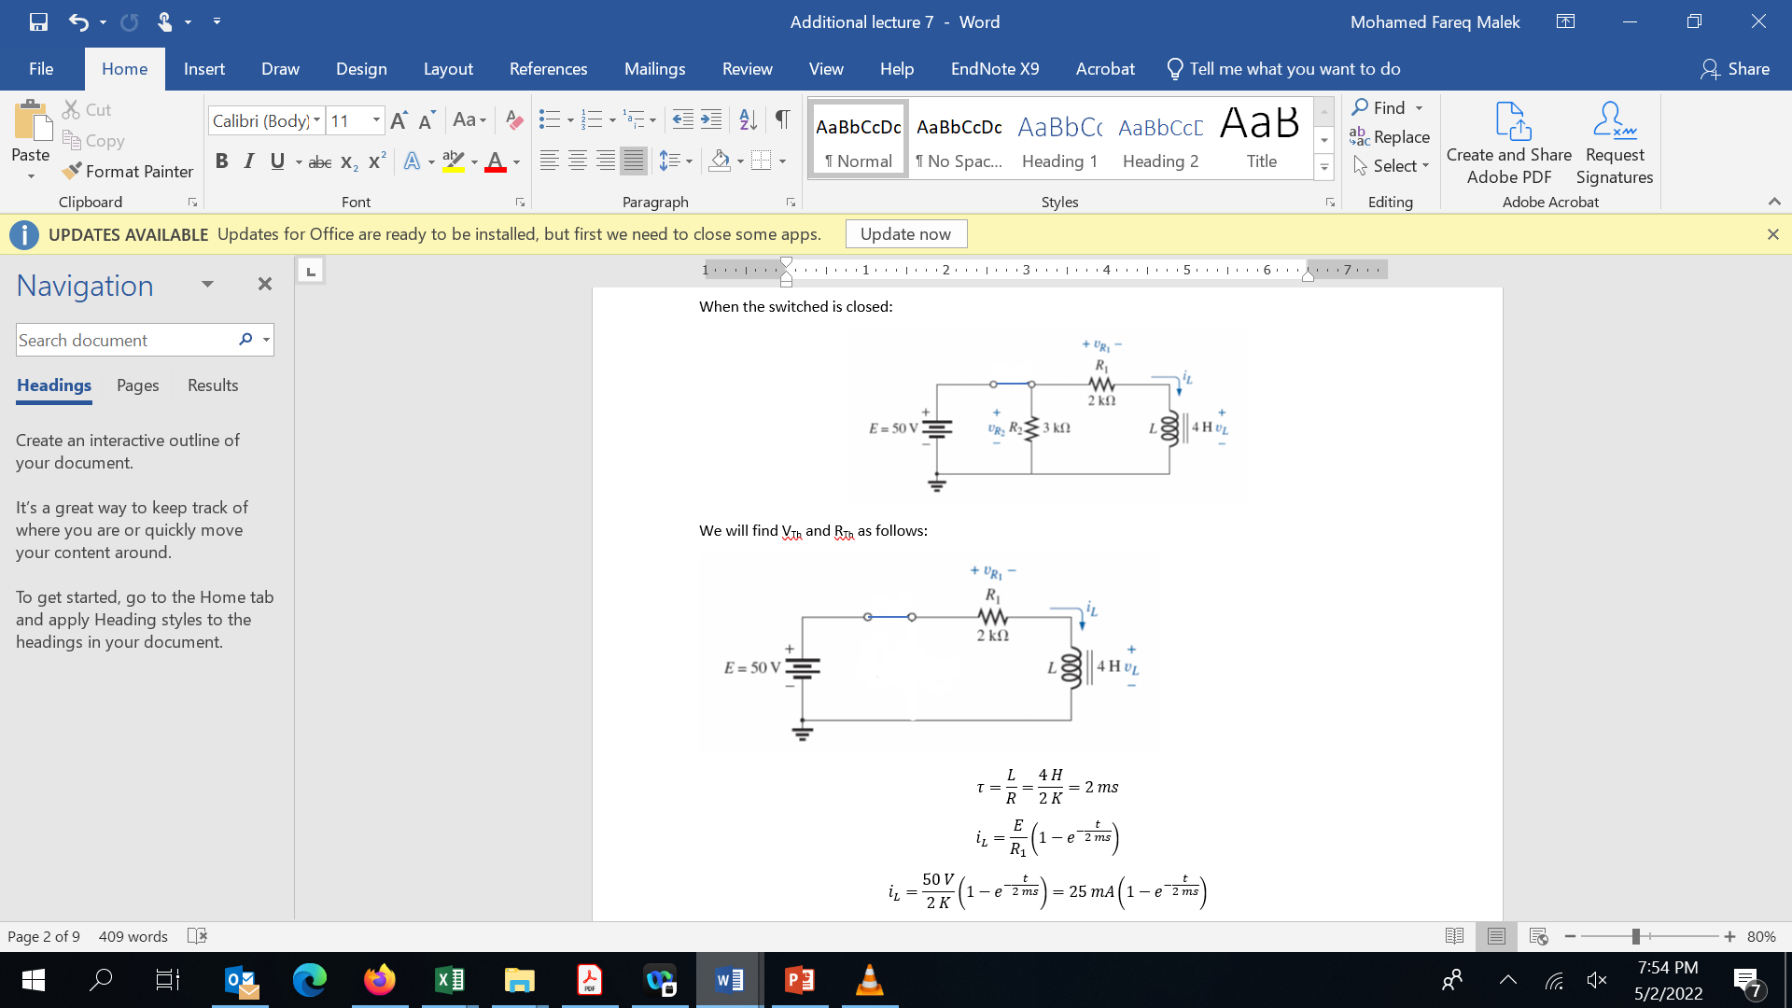
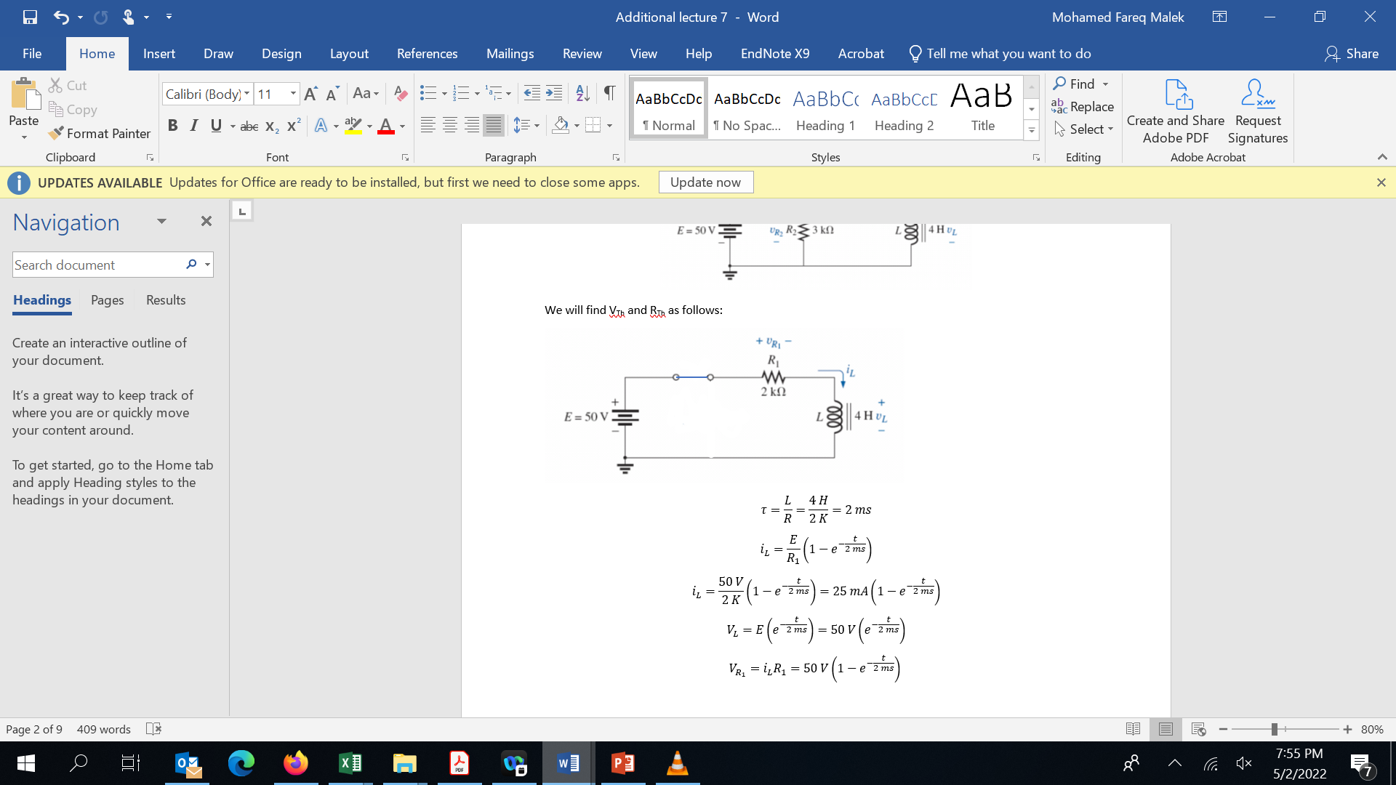

Slide 42
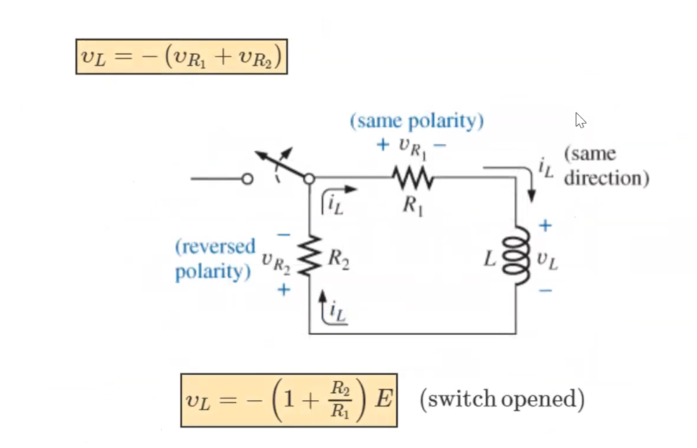
solution

Slide 43
Energise and De-energise
KVL: when VL=50, VR1=0, when VL=0, VR1=50 (because L and R1 are in series)
VR2= 50 Volts. Constant value. Because VR2 is in parallel to E

Slide 44
Challenge problem
FIG. 11.46 Example 11.6.

Slide 45
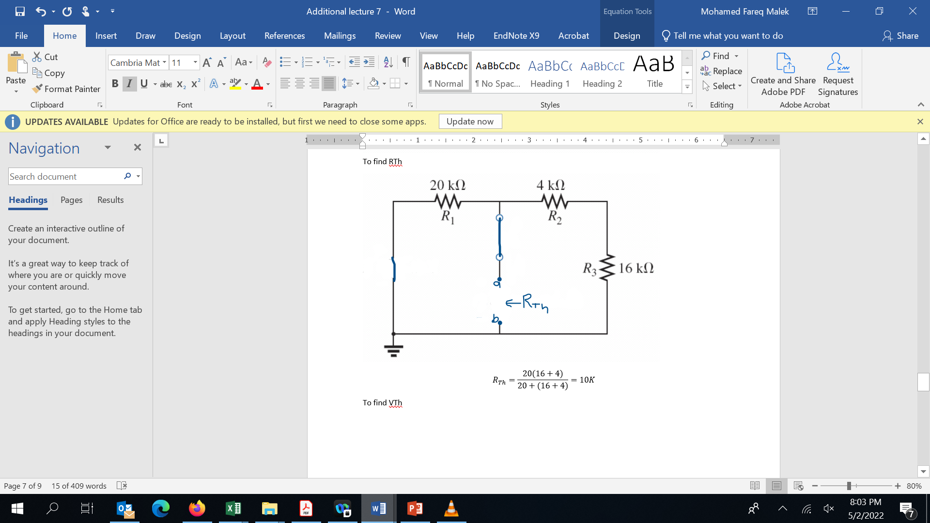
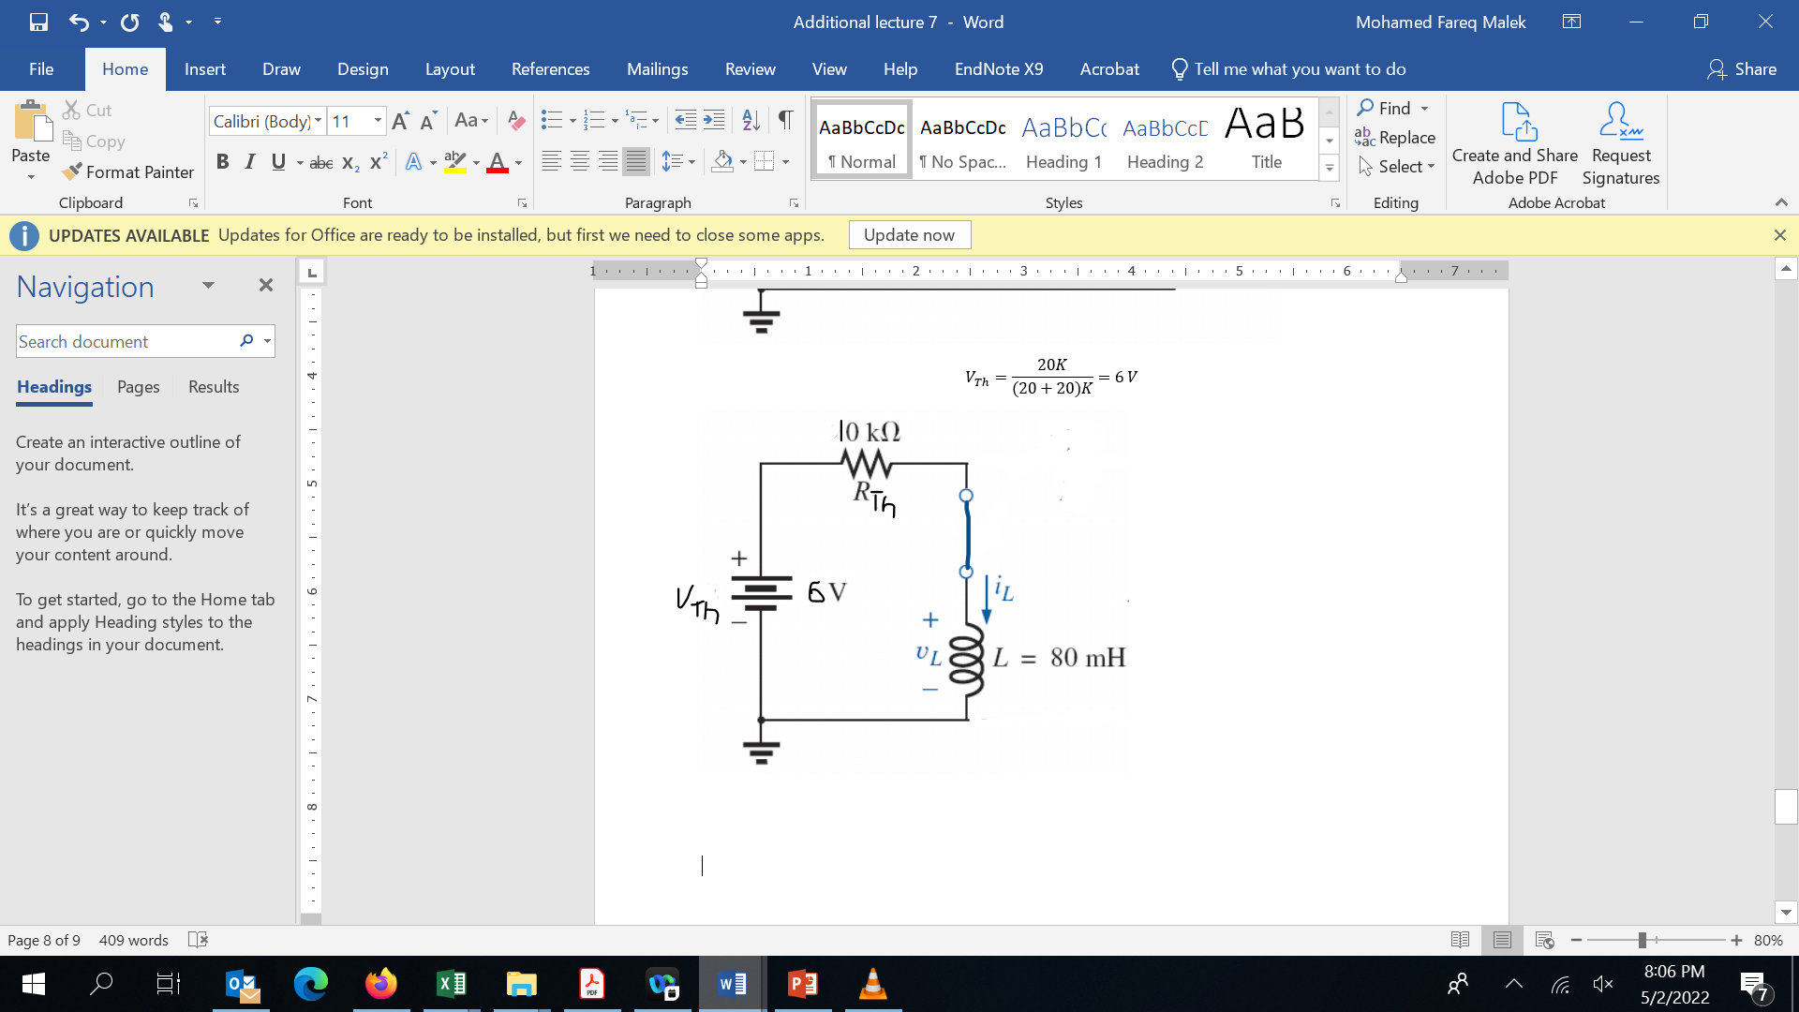
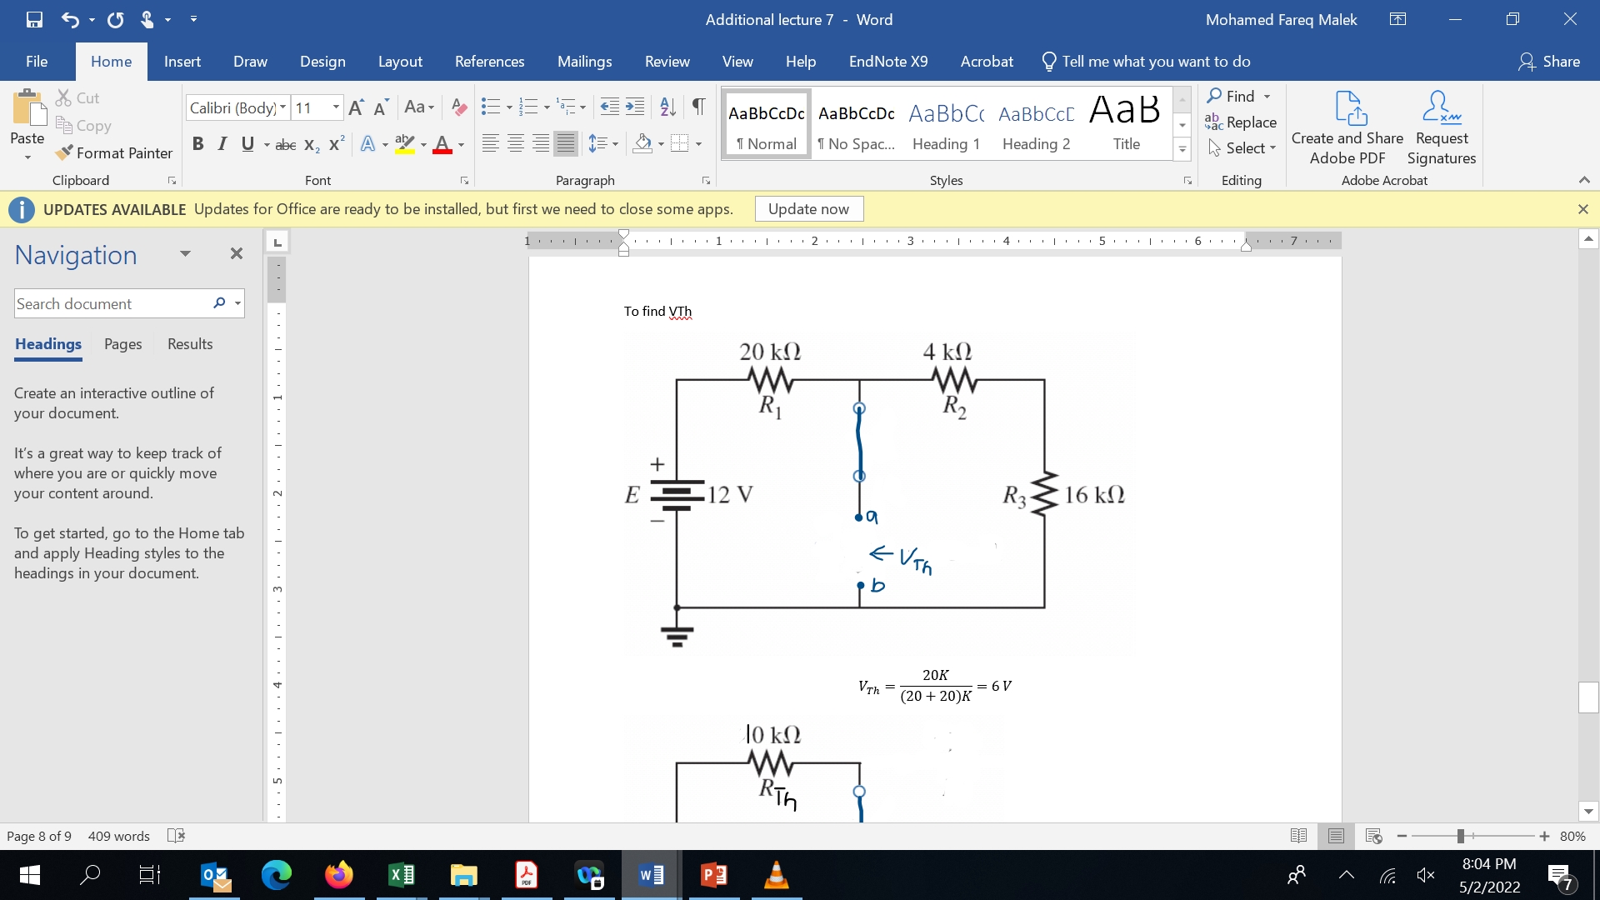
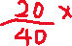
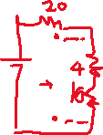

Slide 46
FIG. 11.50 The resulting waveforms for i_{L} and v_{L} for the network in Fig. 11.46.

Slide 47
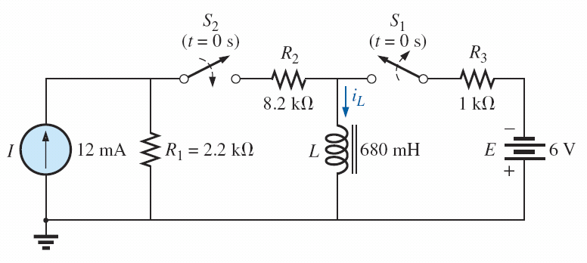
Another Challenge
Switch S1 has been closed and S2 open then time = 0 they are both toggled. Find the curve for i_{L}
(too difficult for final exam, just test yourself)
FIG. 11.51 Example 11.7.

Slide 48
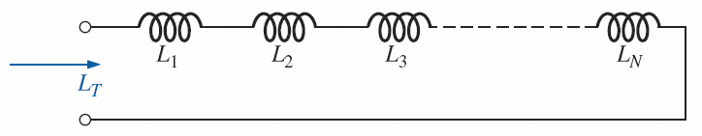
INDUCTORS IN SERIES AND IN PARALLEL
Inductors, like resistors and capacitors, can be placed in series or in parallel.
Increasing levels of inductance can be obtained by placing inductors in series, while decreasing levels can be obtained by placing inductors in parallel.

Slide 49
Steady state conditions
for all practical purposes, an ideal (ignoring internal resistance and stray capacitances) inductor can be replaced by a short-circuit equivalent once steady-state conditions have been established.
Recall that the term steady state implies that the voltage and current levels have reached their final resting value and will no longer change unless a change is made in the applied voltage or circuit configuration.

Slide 50
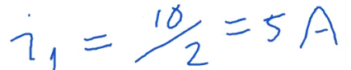
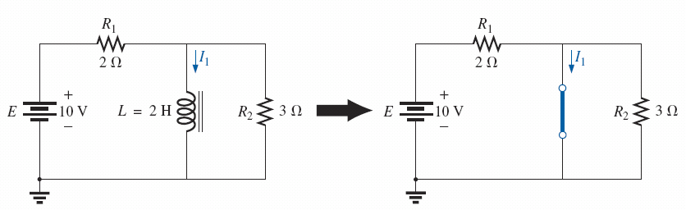
Steady state
Substituting the short-circuit equivalent for the inductor for t > 5_{t}.

Slide 51
Steady State
Establishing the equivalent network for t > 5t.

Slide 52
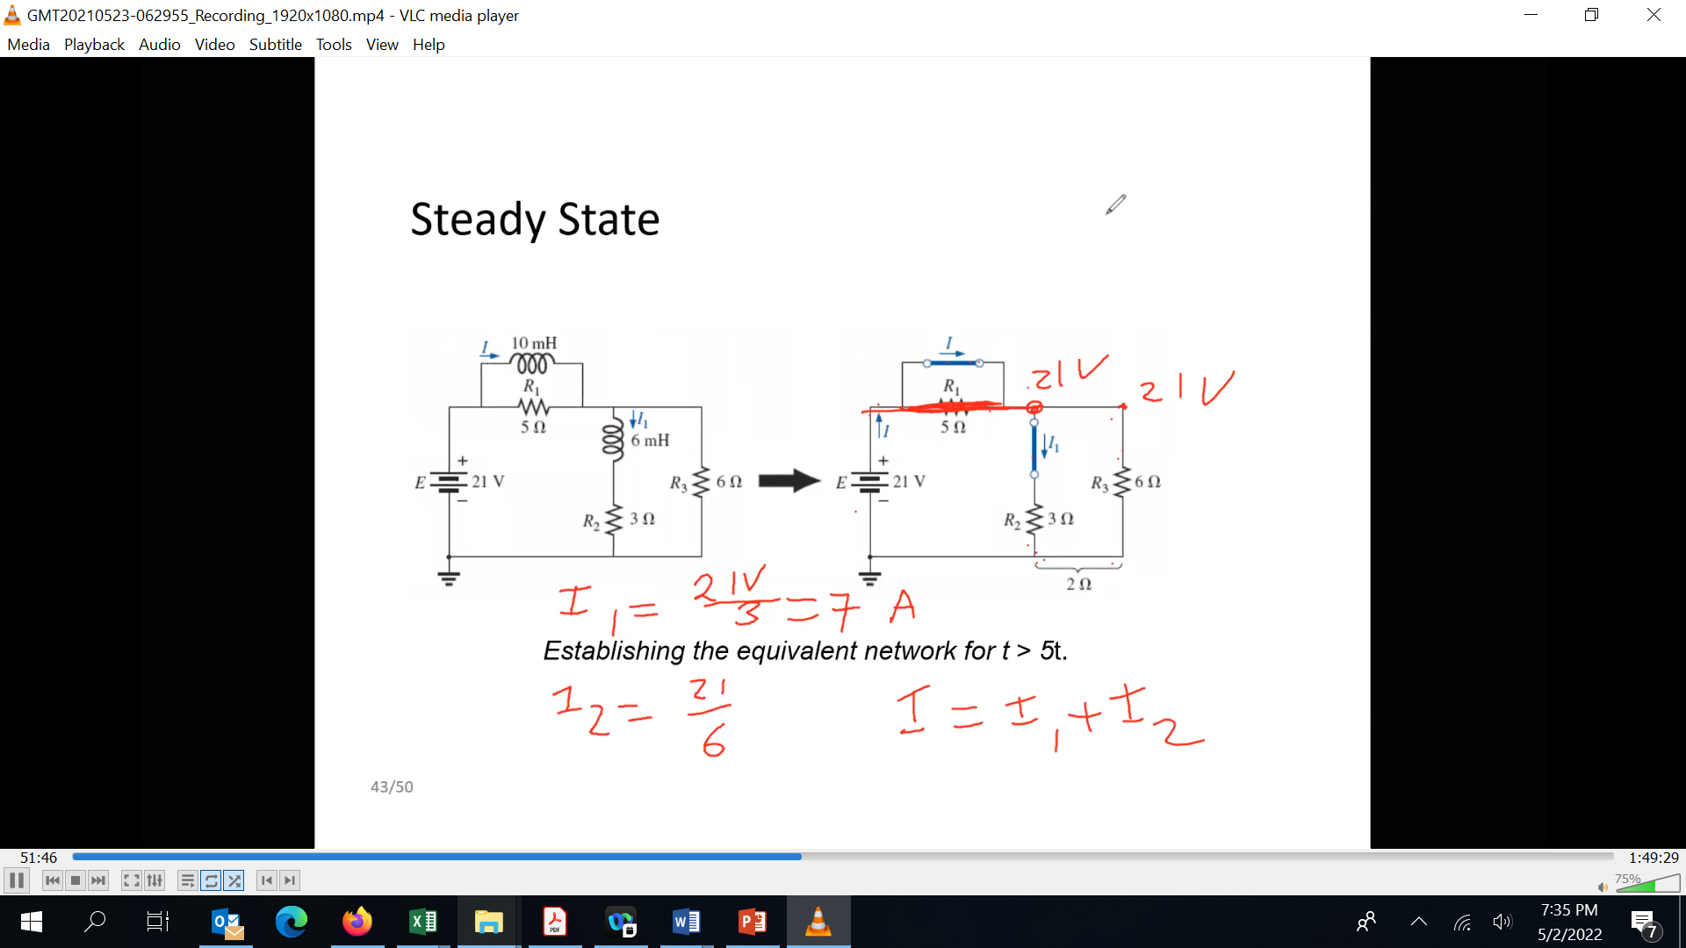




Slide 53
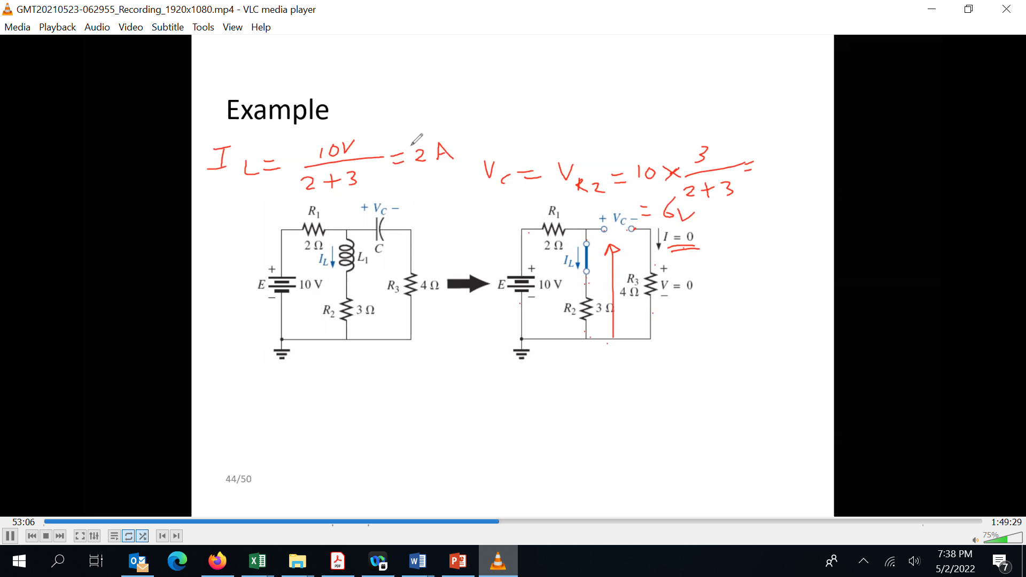
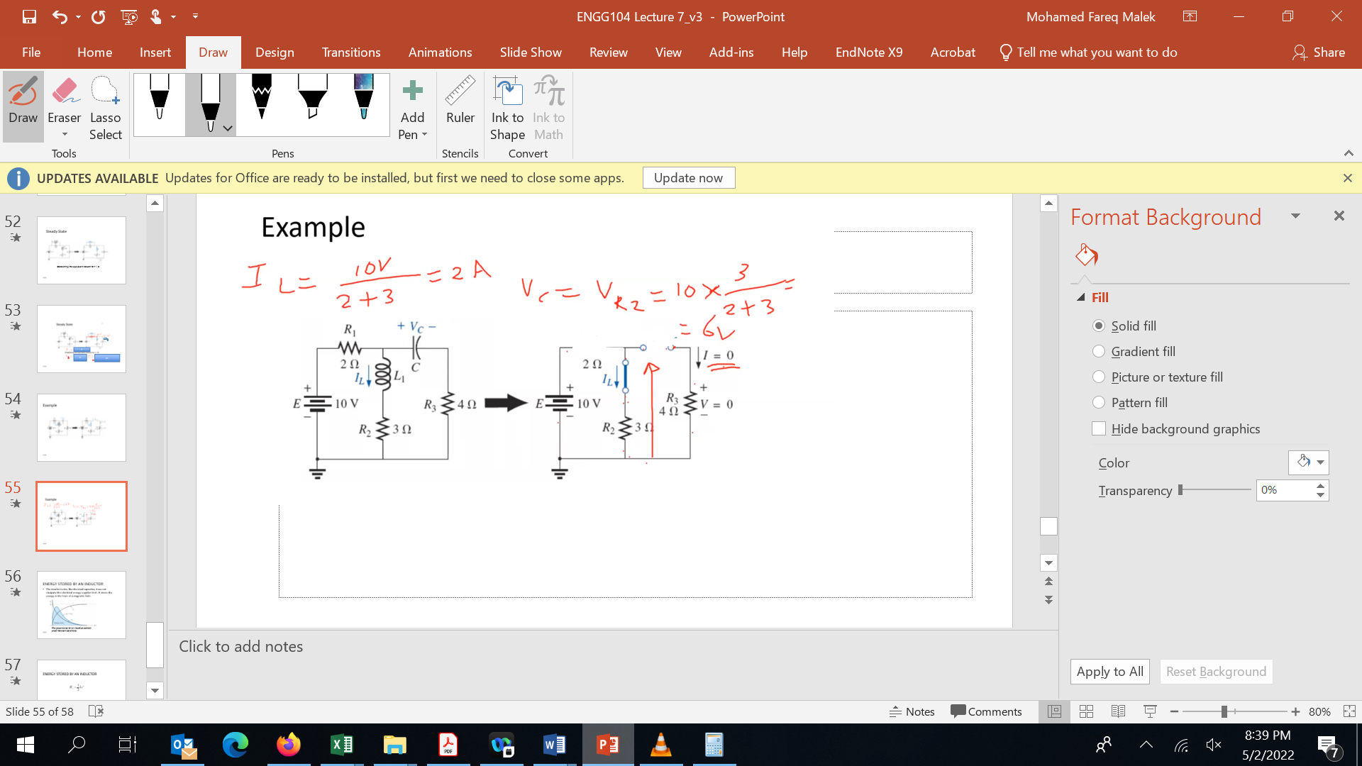
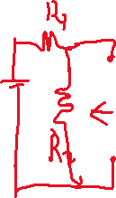
Example

Slide 54
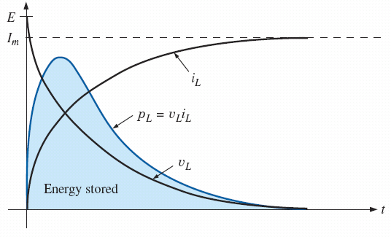
ENERGY STORED BY AN INDUCTOR
The ideal inductor, like the ideal capacitor, does not dissipate the electrical energy supplied to it. It stores the energy in the form of a magnetic field.
The power curve for an inductive element under transient conditions.

Slide 55

ENERGY STORED BY AN INDUCTOR
The energy stored in an inductor is a function of the inductance and the current in it

Slide 56
Lecture 7 summary
Self Inductance
Induced Voltage
Inductors in Series and Parallel
Transients in R-L circuits
Time Constants
Energy Storage

